Slide 1


Physical Human-Robot Interaction
Andrea Calanca
Notes:
Welcome to this tutorial on compliant control …
I am andrea calanca the tutorial organizer. Accordingly to the online schedule I will give the first presentation introducing estabilished concepts of compliant control. Then we will listen the words of … then both proposed recent advances in the area. Then I will give a final presentation introducing a novel approach to control.

Slide 2
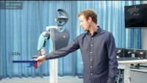
Introduction
https://www.youtube.com/watch?v=sbhiNNIxMNQ

Slide 3
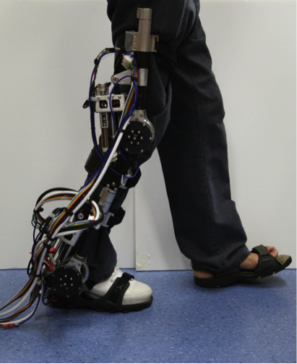
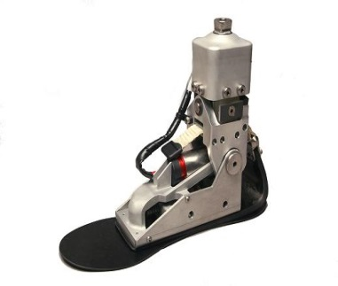
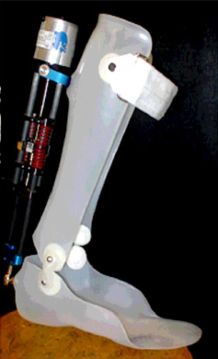
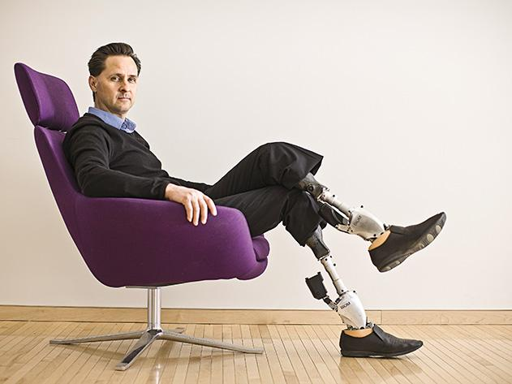
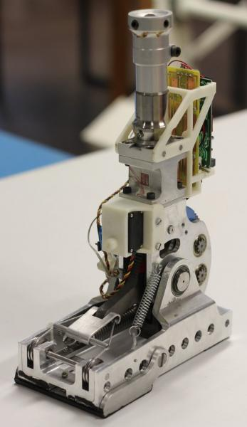
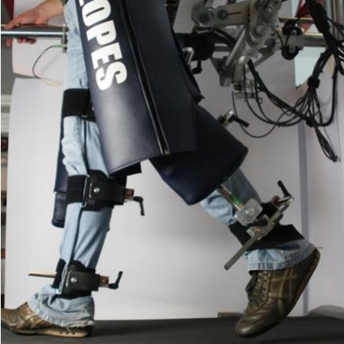
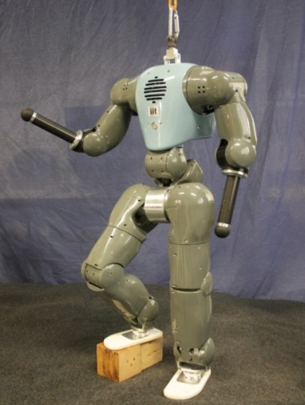
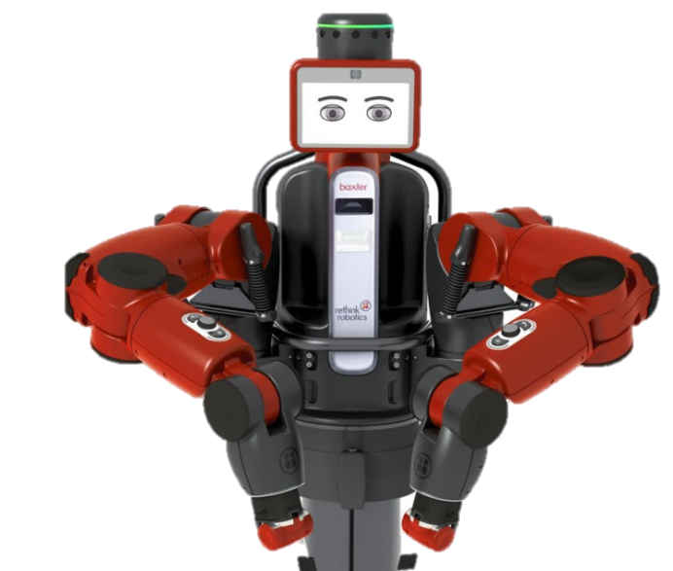

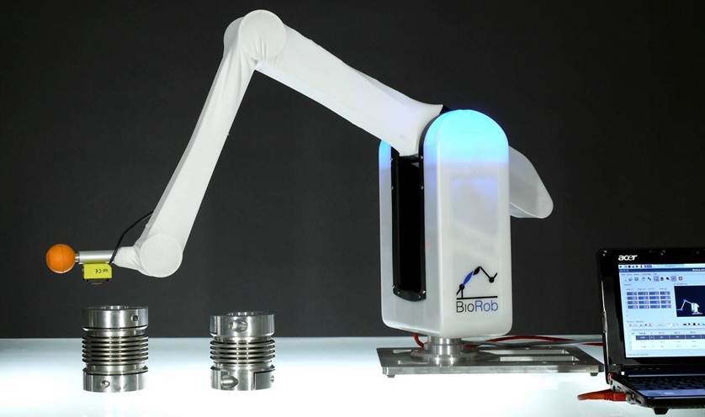
Introduction
Compliant robots
Notes:
But lets start by showing to you some examples of compliant …
As for example well known rehabilitation robots or robots that are specifically designed to interact with the humans
The compliant behaviour of all these robots is due to both mechanics and control. In fact these robots uses elastic actuators which include a physical elastic element together with the motor.

Slide 4
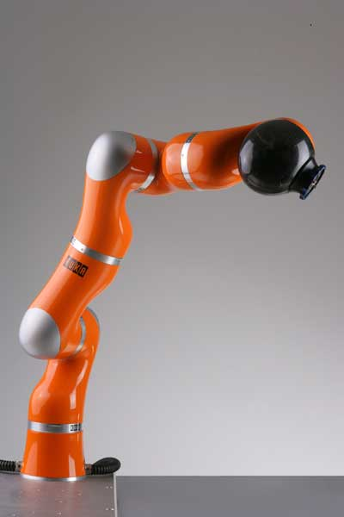

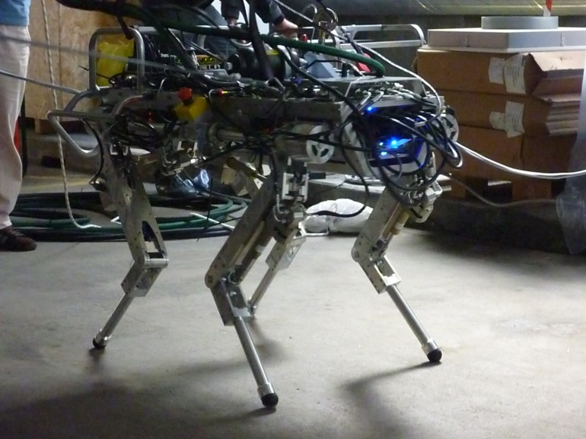
Introduction
Are elastic actuators the only way to get a soft behaviour?
Notes:
However we know that there exist several examples of compliant robots which are based on stiff actuator like for example the …
In these case the soft behaviour is entirely due to control

Slide 5
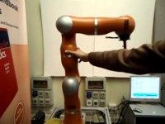
Introduction

Slide 6
Genesis of the course
We read tons of papers from the ’70s to nowadays and we try to summarize them for you, focusing on practical aspects
A huge literature, different backgrounds, nomenclature, and applications
Intended audience: engineers who want to design and control a robot
This is not a fully theoretical course. We will explain principles and guidelines for designing and controlling your hardware
Control is hardware dependent!!
We brought back control architectures to a common and simplified scenario
Sometimes multidimensionality complicates things… (e.g. impedance control by Hogan)
Notes:
In this tutorial we aim at proposing a unified view of past and present literature
To describe and compare different approaches we decided to..
By this revision of literature we aim to propose a sort of handbook
to guide engineers in their compliant actuator design
to explain …
and to provide …

Slide 7
In this course
You will learn theoretical principles and you will put this theory into practice
You will learn not only how to design a low-level robot controller but also how to implement it
You will learn advantages, drawbacks, and implementation issues of different control schema by your own experience
To do that you need to have strong background on control theory and robotics

Slide 8
Interesting quotes…
"In theory, there is no difference between theory and practice. But in practice, there is." — Jan L. A. van de Snepscheut (also attributed to Yogi Berra)
"Tell me and I forget, teach me and I may remember, involve me and I learn." — Benjamin Franklin
"What I hear, I forget. What I see, I remember. What I do, I understand." — usually attributed to Confucio (“I hear and I forget. I see and I remember.)

Slide 9
Material to recover your background on control theory
Here you can find some lessons to for the required control theory background
https://www.youtube.com/watch?v=oBc_BHxw78s&list=PLUMWjy5jgHK1NC52DXXrriwihVrYZKqjk
You need to follow the "Classical Control System" playlist. You can skip the following topics: Routh Hurwitz Criterion, Nyquist Criterion.
Other useful links
https://resourcium.org/
https://sites.google.com/sheffield.ac.uk/controleducation/chaptermaths/sectionmathsalevel?authuser=0

Slide 10
Course Info
Material
Slides, Notes, Papers and Chapters provided by the teacher.
Slotine, J.-J. E., & Li, W. (1991). Applied Nonlinear Control. Prentice Hall. http://openurl.ingenta.com/content/xref?genre=article&issn=0003-7028&volume=62&issue=7&spage=174
Brogliato, B., Maschke, B., Lozano, R., & Egeland, O. (2007). Dissipative Systems Analysis and Control: Theory and Applications. Springer-Verlag London. https://doi.org/10.1007/978-1-84628-517-2
Lessons hand notes

Slide 11
Course Info
Question and answer:
Receiving hours: after class or in the lab.
“During the lesson” is the best option for asking questions!
Exam:
A bit to be defined but the idea is: Homework assignments + Project with Oral Exam
(Maybe this year we skip homework assignments)

